Slide 1
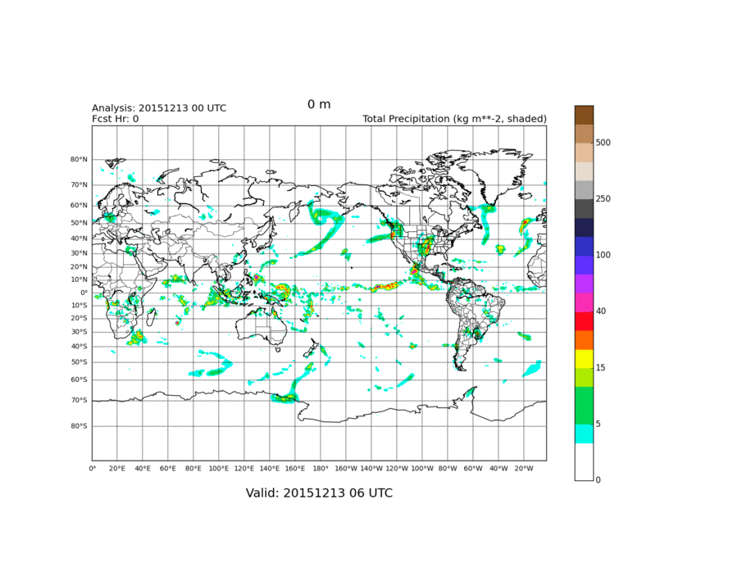
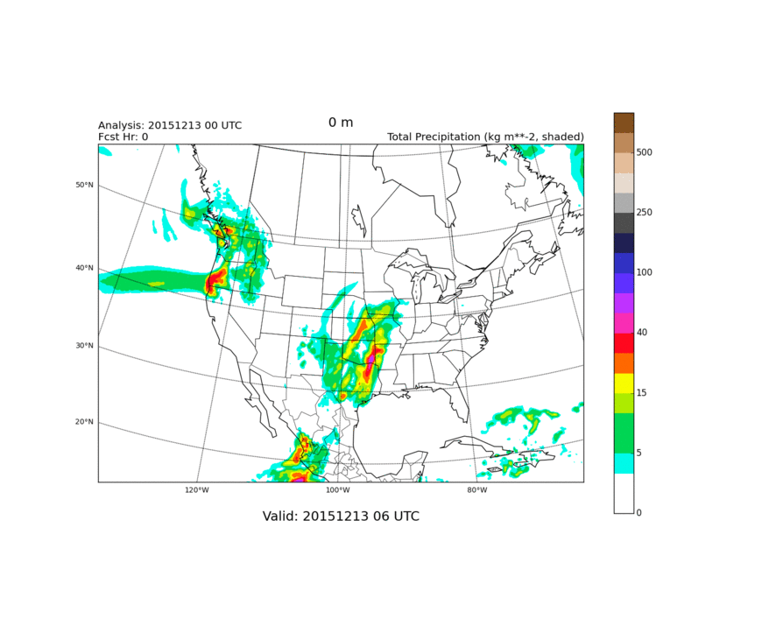
GMTB Workflow: Graphics
Accumulated Total Precipitation
Standard, automated graphics on the same grids as verification
NCEP G218 Grid
NCEP G3 Grid
Flexible Python graphics scripts
Configuration options for different regions (from global 0.25° grid)
Notes:
Examples of the daily loops of 6-hr accumulated Total Precip. Capability to produce figures of convective and large-scale, too.
Necessary fields are saved for later aggregation for seasonal averages.
Flexibility allows for additional sets of figures to be added with only a few additional lines of configuration options (2-3 lines).
Options for configurable regions. Currently includes latitude bands, such as tropics and extratropics as a configuration option. Infrastructure exists to include other specific regions of interest.

Slide 2
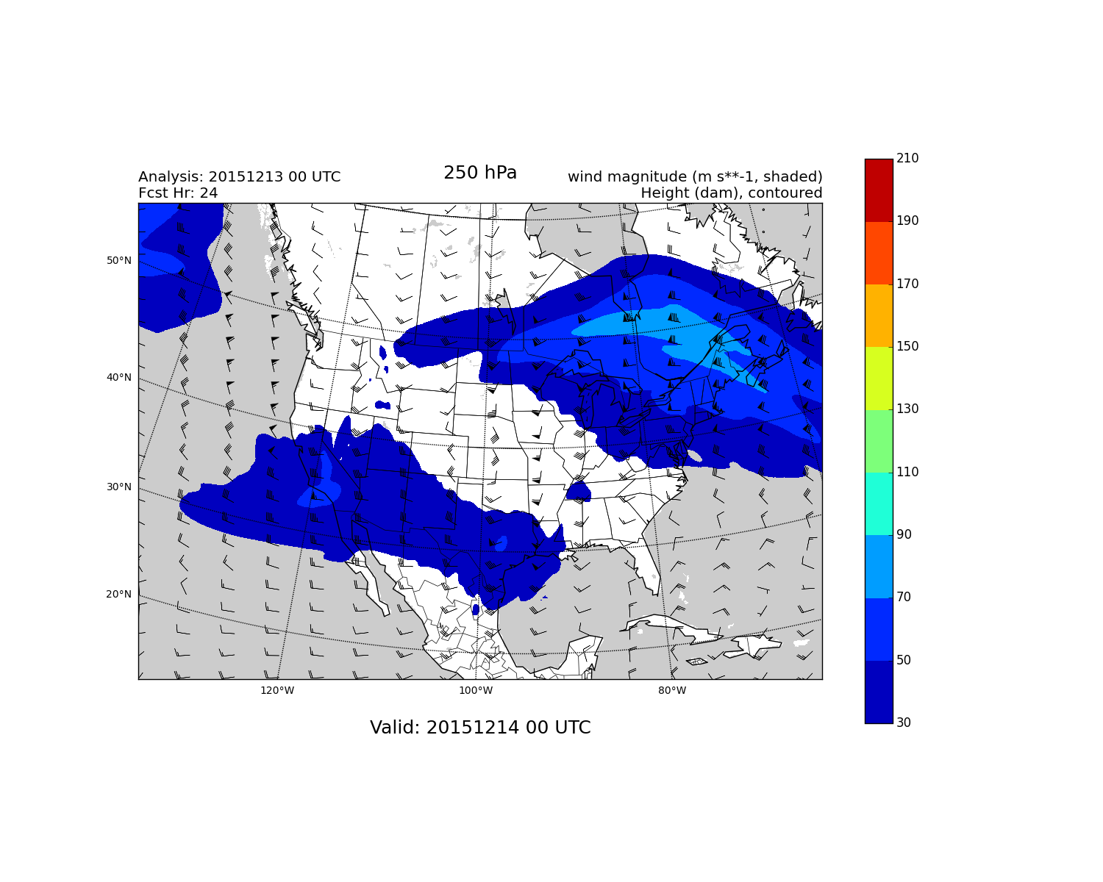
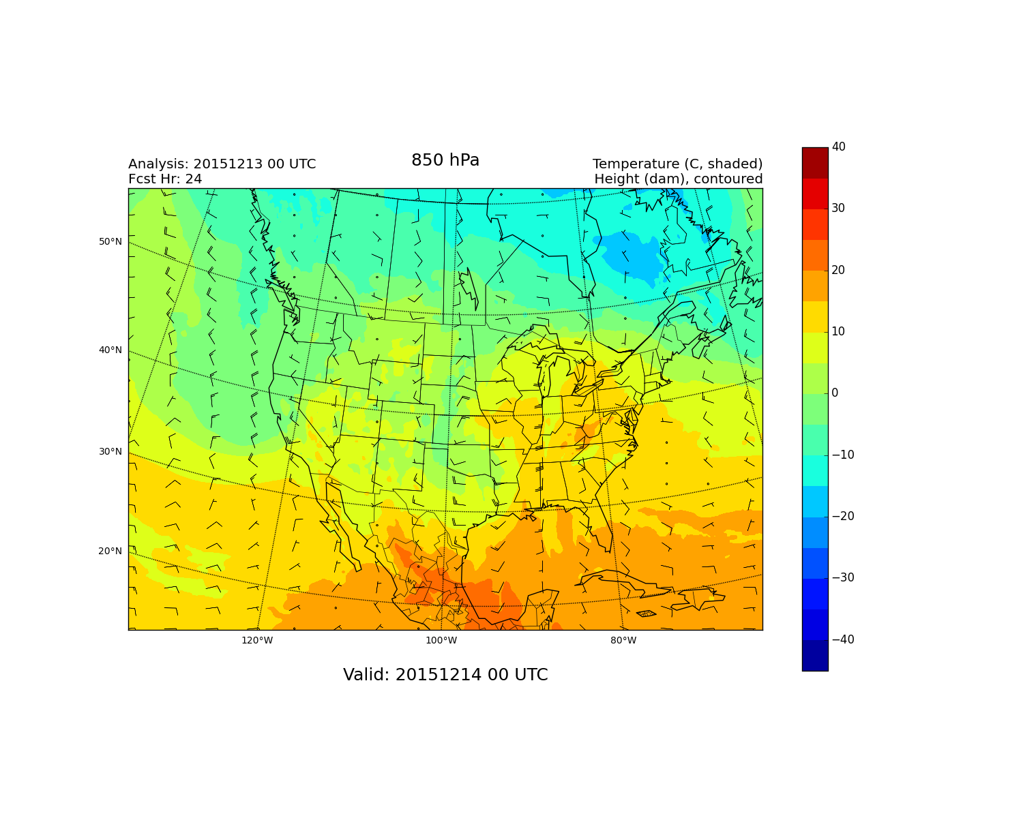
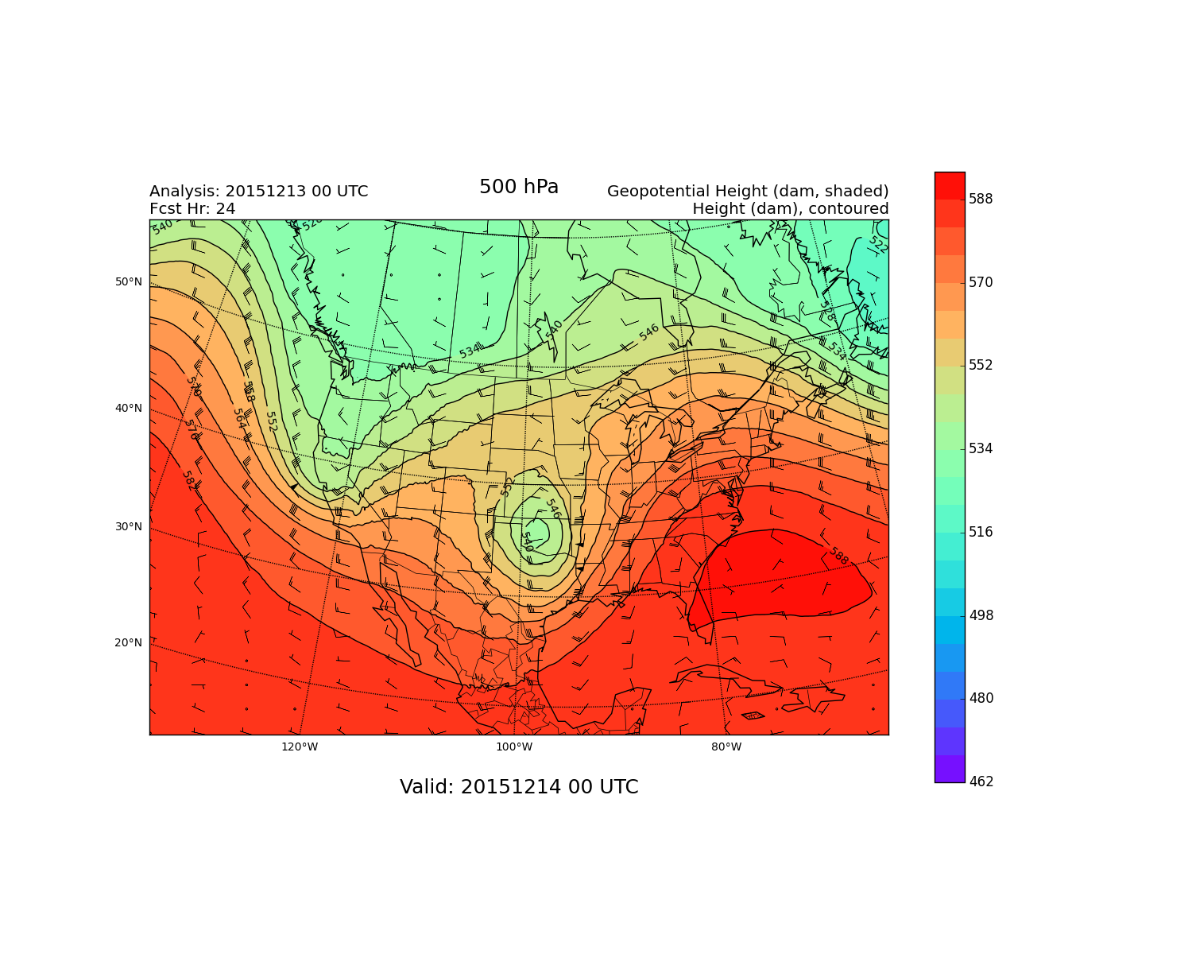
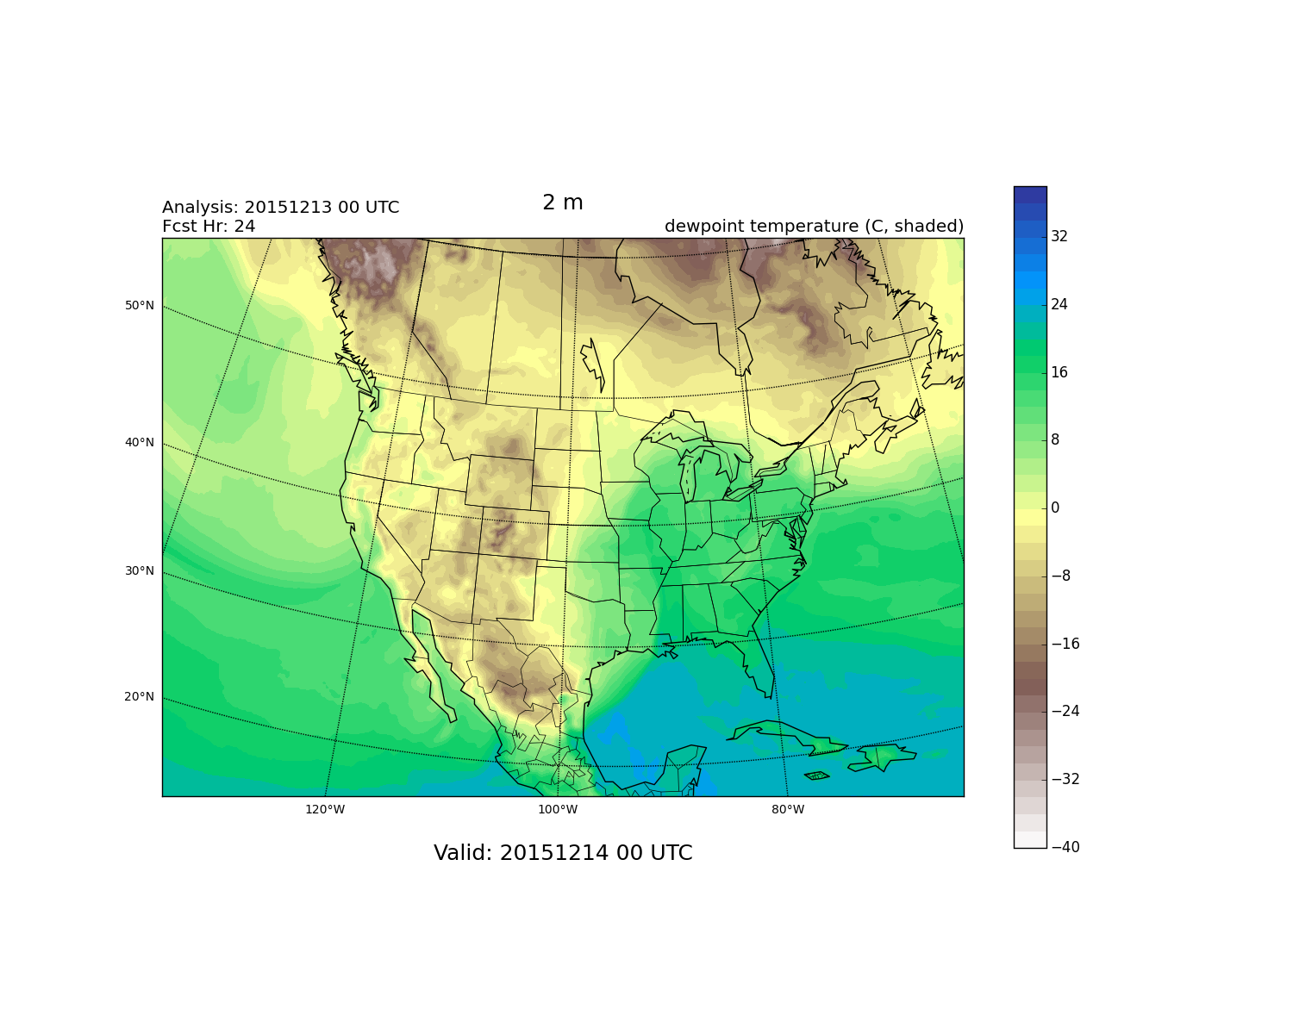
GMTB Workflow: Graphics
Upper air and surface fields
250 hPa Wind
850 hPa Temp
Many more…
2 m: T, Td
850: T, RH, HGT
700: T, W
500: T, HGT
250: T, Wind
500 hPa Height
2 m DewPt Temp
Notes:
Just a few examples of the standard graphics that are generated in the workflow.
Similar graphics package exists to plot the Regression Test, but I don’t know that that information goes in this presentation.
The object oriented scripts allow for flexibilty in generating graphics from any grib source. A top-level script calls the same sets of map objects to create each image with minimal code duplication.

